Slide 1
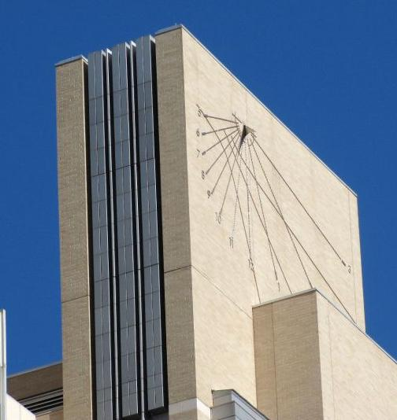
Civil Pro Bono Panel Appointment Procedures
U.S. District Court, District of Colo.
Attorney Services Division

Slide 2
Agenda
Panel Program Origins
Cases Not Subject to Appointment
Local Attorney Rule 15
Organization Chart
Faculty of Federal Advocates
Benefits
Appointment Philosophy
Paperwork / Forms
Contact information

Slide 3
A MESSAGE FROM CHIEF JUDGE PHILIP A. BRIMMER
The willingness of lawyers to undertake representation of pro se litigants in these challenging times is a testament both to their commitment to improving access to justice and the commitment of the Faculty of Federal Advocates to the Pro Bono Panel program. The Court gratefully acknowledges the service of all involved.
I encourage attorneys who are able to assist with pro se matters on a pro bono basis to contact the court’s Attorney Services Division, for a list of cases where help is needed. Thanks very much.

Slide 4
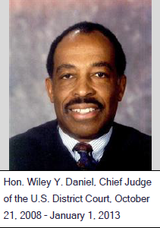
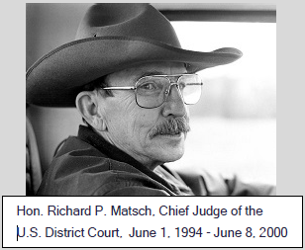
Origins
The U.S. District Court, District of Colorado’s Civil Pro Bono Panel is the offspring of the U.S. District Court's 2011 Strategic Planning Conference under then-Chief Judge Wiley Y. Daniel.
Chief Judge Richard P. Matsch spearheaded in 1997 the creation of a federal court practice organization - led by Colorado law firms - dedicated to enhancing advocacy skills, professionalism and the integrity of the federal judicial system. The federal practice organization, the Faculty of Federal Advocates, that same year sponsored the Counsel/Co-Counsel Program to assist pro se parties in federal district court.
The majority of cases that require pro bono representation has always been prisoner civil rights cases. This was true with the Faculty of Federal Advocates’ Counsel/Co-counsel program, the predecessor to the Panel program, and continues to this day, with approximately 70 percent of pro bono appointments made with prisoner civil rights matters under 42 U.S.C. § 1983.

Slide 5
Cases Not Subject to Appointment
Habeas corpus cases under 28 U.S.C. §§ 2241, 2254 and 2255 are not covered under the Civil Pro Bono Panel program; the Court has the authority to appoint paid counsel, using court funds, under the Criminal Justice Act in those cases.
Criminal cases – again, the Court appoints defense lawyers who are paid a fee.
Bankruptcy Court cases – the Faculty of Federal Advocates has a separate pro bono program (though occasionally bankruptcy appeals become available in the district court and the Civil Pro Bono Panel program).
U.S. Tax Court cases, Immigration Court cases, etc. – only if matters are filed in the U.S. District Court, such as emergency immigration removal cases.

Slide 6
Local Attorney Rule 15
Prerogatives of judicial officers.
(A) A judicial officer to whom the civil action is assigned may on motion by an eligible, unrepresented party or on his or her own initiative enter an Appointment Order authorizing appointment of a member of the Panel to provide general or limited representation, directing the clerk to select an attorney with a relevant subject matter preference or expertise.
(B) In deciding whether to appoint counsel, the judicial officer should consider all relevant circumstances, including, but not limited to, the following:
(i) the nature and complexity of the action;
(ii) the potential merit of the claims or defenses of the unrepresented party;
(iii) the demonstrated inability of the unrepresented party to retain an attorney by other means; and
(iv) the degree to which the interests of justice, including the benefits to the court, will be served by appointment of counsel.
Duties of the clerk.
(A) No later than 14 days after the filing of an Appointment Order, the clerk shall select a member of the Panel to represent the
unrepresented party using an automated, random selection process.
(B) In making the selection, the clerk shall consider the following:
(i) the existence of counsel who is willing to accept appointment who is already representing the unrepresented party in another action in this court;
(ii) the relevant preference and expertise of the members of the Panel; and
(iii) the equitable distribution of appointments among the members of the Panel, with preference given to counsel already representing the unrepresented party in another action in this court.
(C) On selection of a member of the Panel, the clerk shall contact the member and provide relevant, case-specific documents, e.g., complaint, answer, pending motions, etc. For a law firm, clinic, or non-profit legal organization, the Panel Liaison shall select and maintain assignment of eligible counsel. No later than five days after contact, the member shall notify the clerk whether the member is available for appointment.
(D) On receipt of notice of availability for and acceptance of appointment from the member of the Panel, the clerk shall file a Notice of Appointment and shall serve the unrepresented party with the Appointment Order, the Notice of Appointment, and this rule.
(E) If after four attempts, the clerk is unable to select a member of the Panel who is available and willing to accept appointment, the clerk shall notify the judicial officer who entered the Appointment Order of the unavailability of counsel.
Duties of Court-Appointed Counsel.
(1) On receipt of the Notice of Appointment, the attorney shall communicate promptly with the unrepresented party to determine whether any actual or potential conflict of interest exists and whether the action can be resolved more appropriately in another forum or by other means.
(2) Unless ordered otherwise, no later than 30 days after receipt of the Notice of Appointment, the attorney shall file:
(A) an Entry of Appearance under D.C.COLO.LAttyR 5(a); or
(B) a Notice Declining Appointment stating good cause for declining the appointment.
(3) The appointment of pro bono counsel in the designated civil action does not extend to an appeal after final judgment or in any other civil action.
(4) An attorney appointed under this rule shall represent the unrepresented party from the date of the Entry of Appearance until (A) the court permits the attorney to withdraw;
(B) the case is dismissed;
(C) the case is transferred to another district or remanded to state court; or
(D) final judgment is entered.
Reimbursement of Litigation Expenses from the Reimbursement Fund.
(1) A member of the Panel providing representation to an unrepresented party may apply to the FFA for reimbursement of litigation expenses.
(2) The FFA shall have exclusive, final, non-appealable authority over the funds available to it for reimbursement of litigation expenses and the reimbursement of litigation expenses incurred by a member of the Panel in the representation of an unrepresented party.
(3) The court periodically shall determine the contribution, if any, to the reimbursement fund.

Slide 7
Local Attorney Rule 15
Prerogatives of judicial officers.
The Court appoints counsel based on the merits of the case, and after the case has been screened for exhaustion of remedies and any jurisdictional defects.
Duties of the clerk.
The clerk contacts you, as a Pro Bono Panel member, based on what types of cases you prefer.
[If you did not indicate that you’d accept a prison litigation case, you still can – just e-mail us:
COD_AttorneyServices@cod.uscourts.gov]
When the clerk contacts you (by e-mail), you’re provided a case summary, important deadlines, a list of the parties in the case, and other important information.
Per the rule, you have five days to preliminarily review the case, and to respond that you’re interested, or not available.
Duties of Court-Appointed Counsel.
If you preliminarily accept the case, the clerk enters a Notice of Appointment in the case, and you then have 30 days to contact the client, enter a representation agreement, and enter your appearance in the case … or, you can still decline accepting the case.
Your representation will end on the entry of final judgment in the case … you do not have to represent the client on appeal, or for other post-judgment matters.
Reimbursement of Litigation Expenses from the Reimbursement Fund.
The Faculty of Federal Advocates has an application form for reimbursement of litigation expenses: generally this means deposition costs, copying charges, travel expenses, and expert witness fees. There are very specific limitations and conditions. See the FFA website under “Pro Bono Programs.”

Slide 8
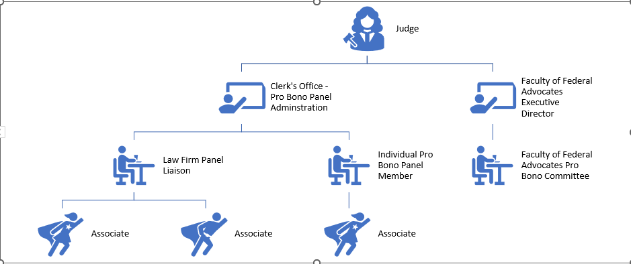
Organization Chart
U.S. District Court Judicial Officers
(District Judges and Magistrate Judges)
(Appointing Officers)
Kiana Anderson
Natasha Jones
Felix Henderson
Isabel Garcia
Tyler Stein
Office manager
Human resources
Project manager
Copywriter
Intern

Slide 9
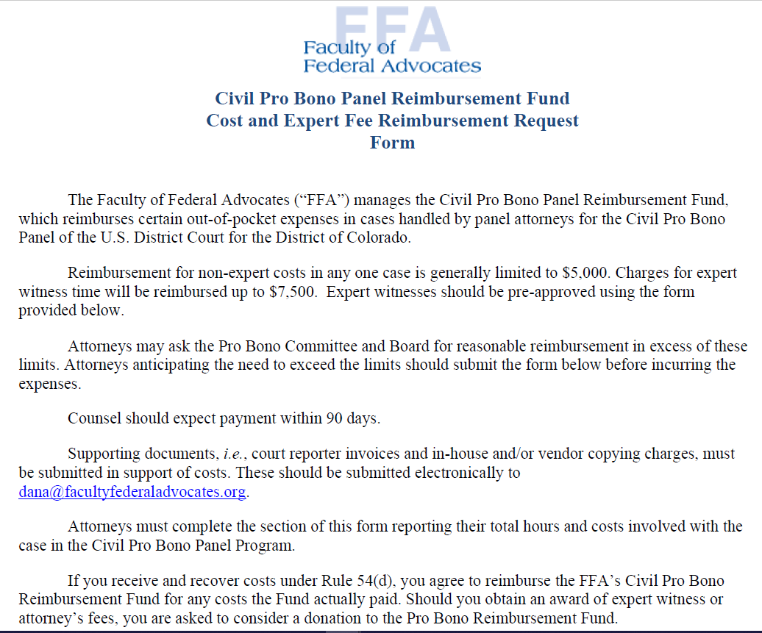
Faculty of Federal Advocates The Faculty of Federal Advocates (“FFA”) manages the Civil Pro Bono Panel Reimbursement Fund, which reimburses certain out-of-pocket expenses in cases handled by panel attorneys for the Civil Pro Bono Panel of the U.S. District Court for the District of Colorado.

Slide 10
Benefits
Limited Representation
Attorneys are permitted to represent unrepresented parties on a limited basis; for example, amending the complaint, dispositve motion briefing, or representation at a hearing.
Mentoring Help
Fee Agreements
The clerk can attempt to pair you with a more experienced attorney
Or, attorneys with prior pro bono litigation experience in the subject matter of your case can act as informal advisors
LAttyR 15 permits counsel to enter into a contingent fee agreement, or in the alternative, retain attorney fees that are earned if the unrepresented party recovers attorney fees or a monetary award or settlement.
Malpractice insurance
Reimbursement of Costs
Malpractice insurance is provided by the Faculty of Federal Advocates for all Panel cases.
Pro Bono Mediation Panel
Pro bono mediation services are also available for cases assigned through the Civil Pro Bono Program. Mediation specialists have volunteered to provide these services on a pro bono basis. For more information, please contact the Attorney Services Division at 303-335-2466 or email COD_ProBonoPanel@cod.ucourts.gov.
See the “Pro Bono Programs” page on the FFA website
FFA Reimbursement rules are explained on the “FFA Civil Pro Bono Reimbursement Form.pdf “
Reimbursement for non-expert costs in any one case is generally limited to $5,000. Charges for expert witness time will be reimbursed up to $7,500.

Slide 11
Benefits
Variety of Cases
Panel members can specify which types of cases to accept, from the following categories:
Civil rights cases
Consumer rights/ credit reporting/ foreclosure cases
Employment discrimination claims
Prisoners' rights cases (42 U.S.C. § 1983 or Bivens)
Social Security appeals
•Other specific categories (counsel can choose from over 100 different federal causes of action), see http://www.cod.uscourts.gov/CourtOperations/RulesProcedures/Forms.aspx#CivilProBono
Free Case Document Access
Included in membership in the Civil Pro Bono Panel program is access to the Panel’s group PACER system login and password to allow counsel to review all case documents and the docket without incurring a fee.
Clerk’s Office Assistance
Training / Tips / Resources
Prospective pro bono counsel may need more information about the case, updated contact information about the potential client, or more time to review the case. Staff are available to help to the extent that they are permitted, which may, copying records such as video clips filed in the case, or seeking an extension of a deadline informally through the appointing judge’s chambers.
The FFA periodically hosts CLE seminars hosted by experienced pro bono litigators
Newsletters, Handbooks, and other resources are available on the “Civil Pro Bono Panel Appointment Procedures” on the Court’s website here:
http://www.cod.uscourts.gov/AttorneyInformation/CivilProBonoPanel-Details,andAvailableCases.aspx

Slide 12
Paperwork / Forms
Civil Pro Bono Panel Application / Panel Forms
Civil Pro Bono Application
Attorney Motion for Panel Appointment
Other Civil Pro Bono Panel Documents
Handbooks, Instructions, and Guides:
Federal Court Prison Litigation Handbook for Attorneys
Limited Representation Guide

Slide 13
Appointment Philosophy
The basic premise of the Civil Pro Bono Panel, and what makes it a viable and realistic tool for attorneys, is the voluntariness of case assignments – counsel who are asked to review a case are not obliged to accept it, and no penalty ensues for declining a case.
Many law firm members of the Panel use the Panel membership and cases as a federal practice training tool and as an expansion of their own in-house training.

Slide 14
Contact Information
Case E-filing Questions – Case Administration Specialists (Docket Clerks)
Attorney Questions (bar membership, fee payments, etc.)
303-335-2026
303-335-2466
For more information, please reach out to: Edward Butler, Legal Officer, 303-335-2043; Ashley Sheehan, Paralegal, 303-335-2114, or e-mail: COD_ProBonoPanel@cod.uscourts.gov.
Faculty of Federal Advocates Reimbursement Questions
CM/ECF Issues
See ”Pro Bono Programs” page on the FFA website:
https://www.facultyfederaladvocates.org/Pro-Bono-Programs
E-mail COD_CMECF@cod.uscourts.gov
For other work questions or concerns, here's a list of numbers that may help:

