Slide 1
The Pitfalls of the Proffer
Sitting Down with the Government in Criminal and Civil Matters
Miller M. Leonard, Esq., Miller Leonard, P.C.
Peter McNeilly, Assistant U.S. Attorney
Jasand P. Mock, Assistant U.S. Attorney
John S. Tatum, Esq., John S. Tatum, P.C.

Slide 2
AGENDA
Introduction of Panelists
Overview of Federal Proffers (Criminal and Civil)
The Defense Perspective
Questions

Slide 3
Introduction of Panelists

Slide 4
Overview of Criminal Proffers

Slide 5
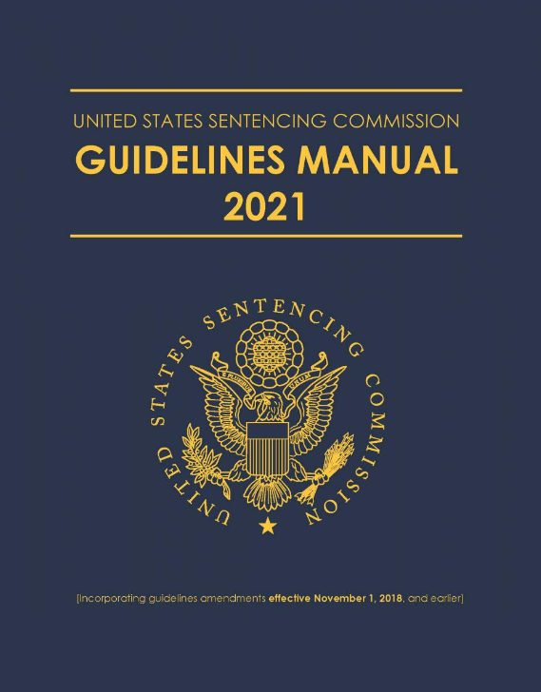
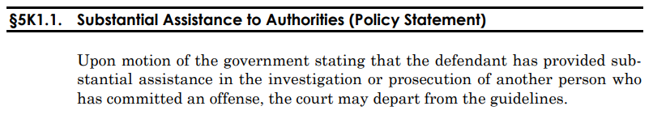
Criminal: Why do defendants proffer?
To Earn Credit Pursuant to USSG §5K1.1 and/or 18 U.S.C. § 3553(e)

Slide 6
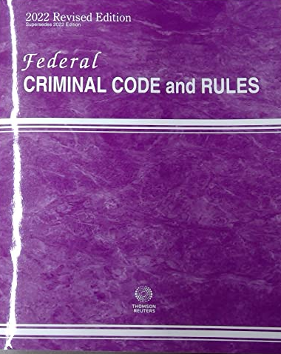
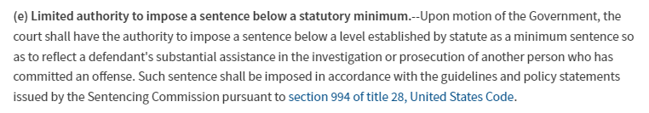
Criminal: Why do defendants proffer?
To Earn Credit Pursuant to USSG §5K1.1 and/or 18 U.S.C. § 3553(e)

Slide 7
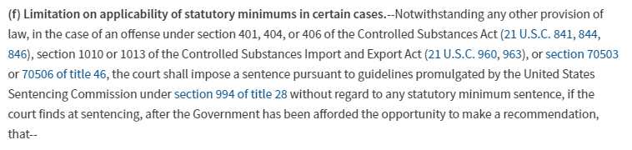
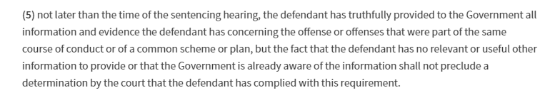
Criminal: Why do defendants proffer?
To Qualify for “Safety Valve” Pursuant to 18 U.S.C. § 3553(f) and a Downward Adjustment Pursuant to USSG §2D1.1(b)(18)

Slide 8
Criminal Proffers
Who, When, Where, What?
How does the proffer actually go?
Defendants need to choose whether they are fighting the case or working to resolve it.
What does the government want?
What does the defendant get out of it?

Slide 10
Overview of Civil Proffers

Slide 11
Civil: Why do defendants proffer?
To be considered for cooperation credit.
Opportunity to educate and engage with enforcement attorneys.

Slide 12
Affirmative Civil Enforcement
False Claims Act
Controlled Substances Act
Financial Institutions Reform, Recovery and Enfrocement Act (FIRREA)
Procurement Integrity Act
Conflict of Interest Laws

Slide 13
Parallel Proceedings
Comprehensive remedies
Information sharing

Slide 14
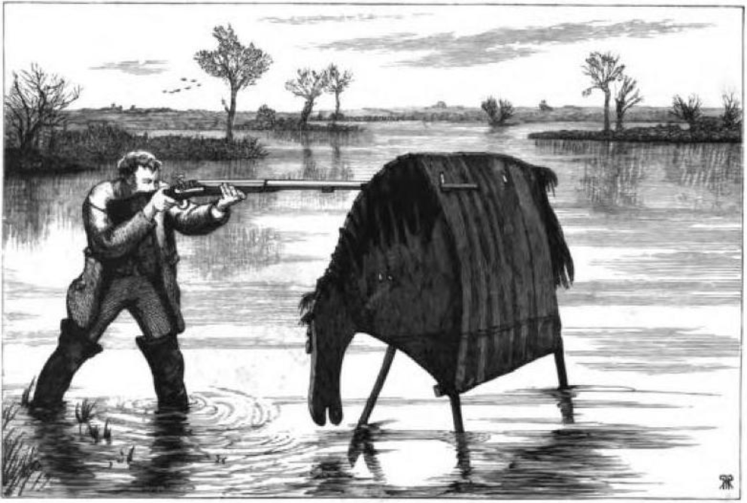
Image courtesy of the University of Toronto and the Internet Archive; https://victorianweb.org/history/sports/10.html
Notes:
OED defines Stalking-Horse, n.
1. A horse trained to allow a fowler to conceal himself behind it or under its coverings in order to get within easy range of game without alarming it. Hence, a portable screen of canvas or other light material, made in the figure of a horse (or sometimes of other animals), similarly used for concealment in pursuing game.
2. figurative.
a. A person whose agency or participation in a proceeding is made use of to prevent its real design from being suspected.
b. An underhand means or expedient for making an attack or attaining some sinister object; usually, a pretext put forward for this purpose.
Image from the University of Toronto ([You may use this image without prior permission for any scholarly or educational purpose as long as you (1) credit the University of Toronto and the Internet Archive and (2) link your document to this URL in a web document or cite it in a print one.]) https://victorianweb.org/history/sports/10.html

Slide 15
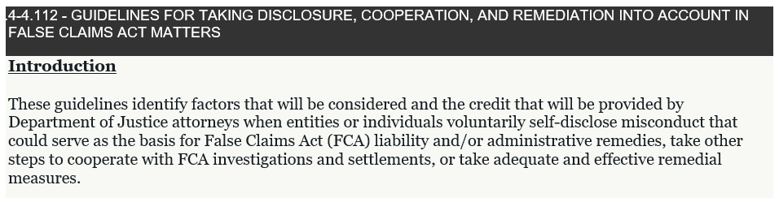
Civil Cooperation Guidelines

Slide 16
Civil Proffers
Many forms of cooperation:
  Voluntary disclosure
  Identifying responsible individuals
  Disclosing relevant facts and documents
NO expectation to waive privileges.

Slide 17
FCA Cooperation Credit
“Where the conduct of the entity or individual warrants credit, the Department has discretion in FCA cases to reward such credit. Most often, this discretion will be exercised by reducing the penalties or damages multiple sought by the Department.”
- Justice Manual 4.4112

Slide 19
The Defense Perspective

Slide 22
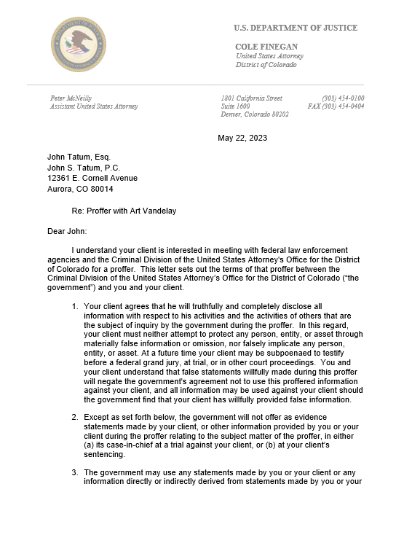
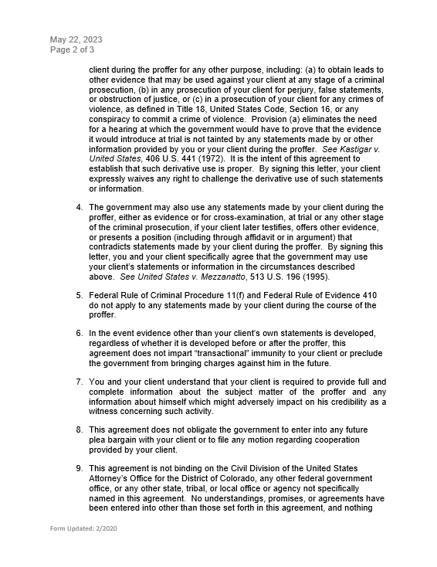
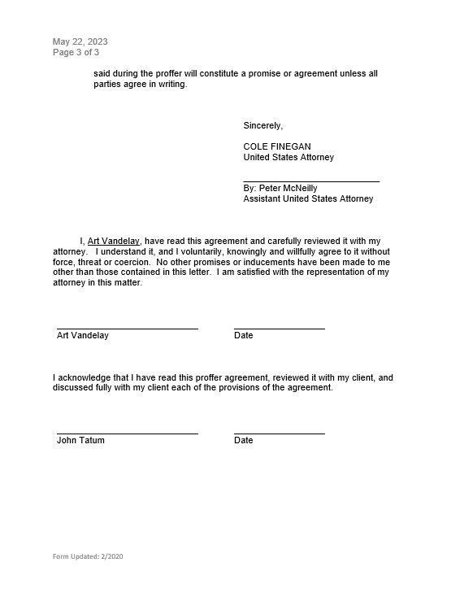
Criminal Proffer Letter

Slide 23
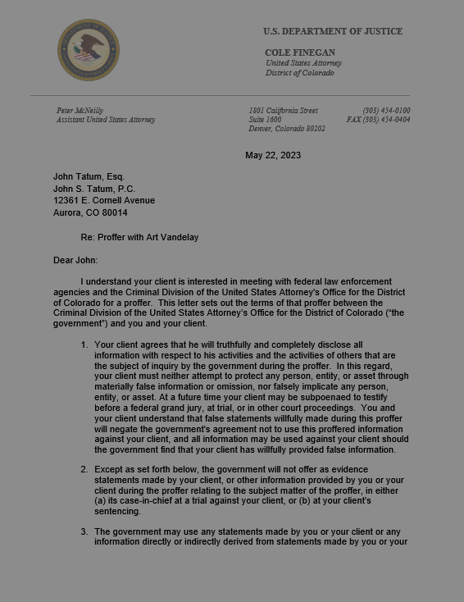
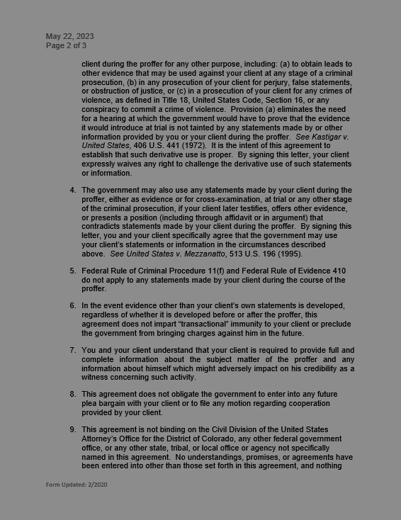
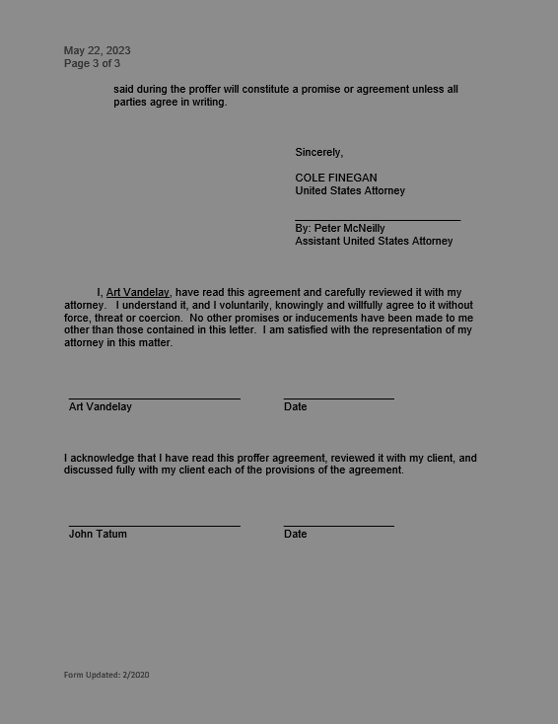
Criminal Proffer Letter

Slide 24
Criminal Proffer Letter

Slide 25
Criminal Proffer Letter

Slide 26
Criminal Proffer Letter

