Slide 1
Objection! Foundation! The nuts and bolts of introducing your exhibits and demonstratives at trial
Marci LaBranche, Stimson LaBranche Hubbard
Kelly Page, Recht Kornfeld

Slide 2
Why Do I Need To Lay A Foundation?
A foundation is necessary to show that the evidence is authentic, reliable and relevant is required for all exhibits
Essentially the who, what, when, where, and why of the exhibit
Important rules of evidence for exhibits:
FRE 104, 106
FRE 402, 403
FRE 803, 804
FRE 901, 902
Important rules of evidence for demonstratives:
FRE 611
FRE 1001

Slide 3
Preparing to Introduce Exhibits at Trial
Does the exhibit advance your theory of the case?
Do you need you the exhibit to go back to the jury or can it be a demonstrative?
When are you introducing the exhibit?
Are you going to publish the exhibit?
Do you need to litigate its admissibility prior to trial?
Build the introduction of the exhibit into your direct/cross/presentation of your case
Stipulations with opposing counsel before trial

Slide 4
Example of Exhibits Built into an Examination
Question | Answer | Source
Were you on duty the night of the crime? | Yes
Did you go to the crime scene? | Yes
Did you take photographs? | Yes
Your honor, may I approach with what has been marked as Defense Exhibits 300-310.

Slide 5
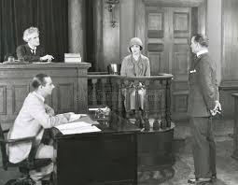
Who Can Authenticate And How?
FRE 901
Testimony of a witness with knowledge
Nonexpert opinion about handwriting
Comparison by expert witness or trier of fact
Distinctive characteristics and the like
Recognition of a voice on an audio recording

Slide 6
Self-Authenticating Records – FRE 902
(11) Certified Domestic Records of a Regularly Conducted Activity
(4) Certified Copies of Public Records.
(6) Newspapers and Periodicals.
(13) Certified Records Generated by an Electronic Process or System.
(14) Certified Data Copied from an Electronic Device, Storage Medium, or File.

Slide 7
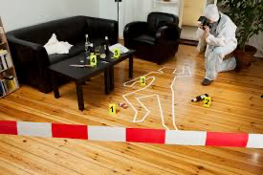
Photograph Exhibits
Does the witness recognize the photo?
How does the witness recognize photo?
Does the witnesses know when the photo was taken?
Who took the photo?
Is the photo a fair and accurate representation of the subject as it appeared at the time?

Slide 8
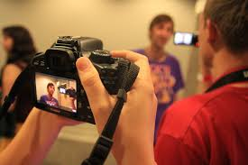
Video Exhibits that Witness Recorded
Did the witness record the incident?
When was the video made?
Was the witness able to view the video before today?
Does the video fairly and accurately depict the scene as it was recorded?
Are there any material alterations or deletions to the videos?
Don’t forget about hearsay issues with these exhibits
If there is hearsay, can you just redact as opposed to excluding the whole exhibit?

Slide 9
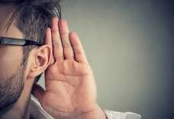
Audio Recordings – FRE 901(5)
Has the witness heard Mr. Smith’s voice before?
Under what circumstances has the witness heard his voice?
How many times has the witness heard his voice?
Has the witness heard the recording marked as Exhibit X for identification?
Does the witness recognize the voice?
Whose voice does the witness recognize on the recording?

Slide 10
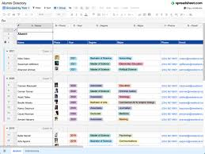
Authenticating Electronic Records with a Testifying Witness
Does the witness’s organization use a computer to keep records?
Is the computer reliable?
Has the organization developed a procedure for inputting data into the computer?
Does the procedure have built-in safeguards to ensure accuracy and identify errors?
Does the organization keep the computer in a good state of repair?
Did the witness have the computer produce a hard copy of certain data?
Did the witness use the proper procedures to obtain the hard copy?
Was the computer in working order at the time the witness obtained the hard copy?
Does the witness recognize the exhibit as the hard copy you produced? How?

Slide 11
E-mails and Text Messages
Proponent must show that the email is what it purports to be. What does that mean?
That it was sent or received by the person claimed to have sent or received it
This can be established through various means, such as testimony from the sender or recipient, or technical evidence showing the email’s metadata.
All methods listed under FRE 901(b)
Do not forget hearsay objections and exclusions

Slide 12
E-mails Are Not Business Records!
….the Court finds that the e-mails bear no indicia of accuracy regarding their content within the meaning of the business rule exception. Instead, they consist of typical written conversations between two or more people in the context of running a business. While such conversations may be necessary to the conduct of the business and while their frequency may be regular, the content of the e-mails varies and does not contain information on which the business relies because that content is accurate, as would a bank, for example, in relying upon its deposit records. Therefore, regarding emails that the government seeks to authenticate, the Court will deny the authentication via Rule 902(11).
Chief United States District Judge Brimmer in US v. Penn et al
Make sure to read United States v. Ary, 518 F3d 775 (10th Cir. 2008) and United States v. Snyder, 787 F.2d 1429 (10th Cir. 1986)

Slide 13
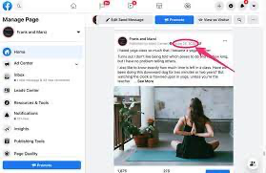
Social Media Exhibits
Need a witness with knowledge
Must have distinctive characteristics
Establishing authorship:
United States v. Brown 834 F.3d 403 (3rd Cir. 2016)
This includes admission of messages sent through social media like Facebook, Snapchat, Instagram, Tik Tok etc.
Best to have recipient of message testifying
Be ready for hearsay objections

Slide 14
Facebook “Like” on Another’s Page
How to authenticate a “like” on someone else’s Facebook page:
1) First, establish who actually authored the like:
Proponent “required to introduce enough evidence such that the jury could reasonably find, by a preponderance of the evidence, that [Defendant] authored the Facebook [like] at issue.”
Preponderance of evidence by distinctive characteristics
2) Second, establish relevance and overcome hearsay objections
US v. Barela,
2021WL5447915 (D. N.M. 2021)

Slide 15
Print Outs of Websites
Government Websites
FRE 902(5) - Official Publications
FRE 803(8) - Public Records
Private Websites
Printouts from non-government websites are not self authenticating.
Proponent must present evidence from a witness with personal knowledge of the website at issue stating that the printout accurately reflects the content of the website and the image of the page on the computer at which the printout was made.
Toytrackerz LLC, v. Koehler, 2009 WL2591329 (D. Kansas 2009)

Slide 16
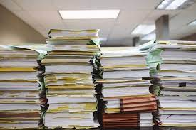
Summary Exhibits: FRE 1006
The proponent may use a summary, chart, or calculation to prove the content of voluminous writings, recordings, or photographs that cannot be conveniently examined in court.
The proponent must make the originals or duplicates available for examination or copying, or both, by other parties at a reasonable time and place.
The court may order the proponent to produce them in court
Can be admitted and sent back to the jury
MAKE SURE TO ASK FOR A LIMITING INSTRUCTION
Cannot be an advocacy piece

Slide 17
Summary Exhibits: FRE 1006
If you’re going to create and admit a summary exhibit:
1) Read the case law:
United States v. Thompson, 518 F.3d 832 (10th Cir. 2008)
United States v. Ray, 370 F.3d 1039 (10th Cir. 2004)
United States v. Renteria, 720 F.3d 1245 (10th Cir. 2013)
United States v. Brooks, 736 F.3d 921 (10th Cir. 2013)
2) Can you meet the two part test for admission:
Does the testimony or chart aid the jury in ascertaining the truth?
Length of trial, the complexity of the case and the possible confusion generated by exhibits
What is the possible prejudice to the defendant/opposing party that may result in allowing such evidence?
Is preparer available for cross? Did the court give a limiting instruction?
3) Provide notice to the court and opposing party

Slide 18
Example of a Limiting Instruction
During the trial, certain summaries prepared by the government and certain defendants were admitted in evidence because they may assist you in understanding the evidence that has been presented. The summaries themselves are not evidence of the material they summarize and are only as valid and reliable as the underlying material they seek to summarize and are only as valid and reliable as the underlying material they seek to summarize. You may give a summary exhibit entire weight, some weight, or no weight at all depending on your assessment of the underlying material and the accuracy of the summary.
Offered and accepted in USA v. Penn

Slide 19
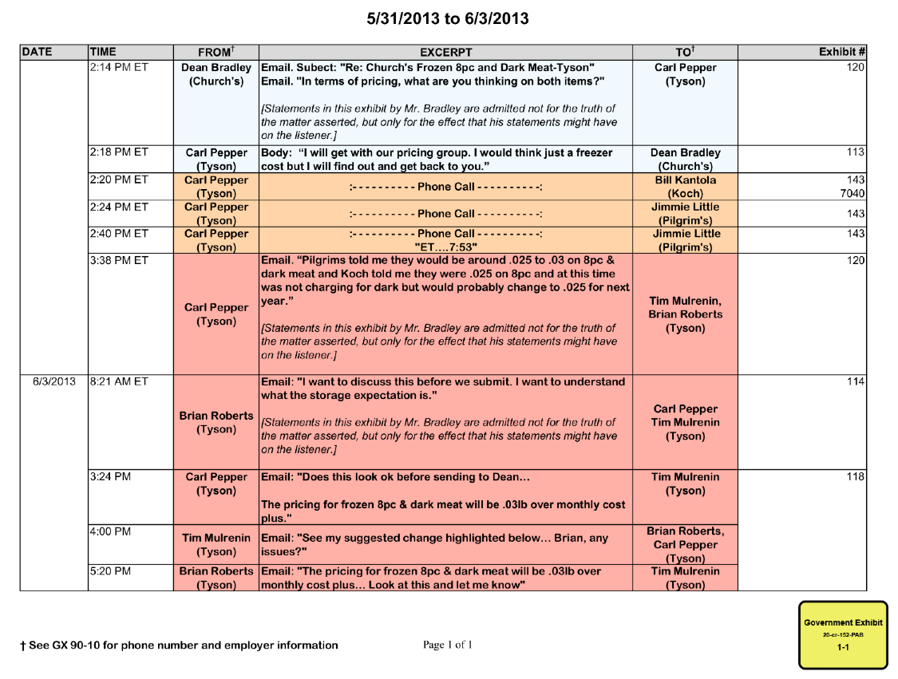
Example of 1006 Summary from US v. Penn

Slide 20
FRE 611(a) Demonstratives
CRE 611(a): The court should exercise reasonable control over the mode and order of examining witnesses and presenting evidence so as to make those procedures effective for determining the truth; avoid wasting time; and protect witnesses from harassment or due embarrassment.
Does not go back to the jury
Not substantive evidence
Same caselaw applies
GET CREATIVE!
Timelines, graphs, pie charts, drawings by a witness on the stand, video recreations

Slide 21
Examples of 611(a) Demonstratives
June 17 9:35 PM
Initial call between Deputy Brown and Tessa Swearengin
June 17 9:47 PM
Deputy Brown calls Detective Burgess
June 17 10:05 PM
Detective Burgess calls Tessa Swearengin
June 17 10:23 PM
Detective Burgess calls Angela Reed
June 17 10:52 PM
Detective Burgess arrives at Reed home
June 17 10:55 PM
Law enforcement leaves the Reed home
June 18 11:29 AM
Angela Reed and all four Reed children arrive at DHS for interviews
June 18
Detective Burgess applies for arrest warrant
June 19 12:56 AM
Tim Reed is arrested

