Slide 1
How to Address Abusive Conduct by a Judge
Jill Langley, TENTH U.S. Circuit Director of Workplace Relations
Jess Mekeel, Federal Administrative Appeals Judge
Notes:
Lynda

Slide 2
Today’s Topics
Federal Judiciary Standards of Judicial Conduct and Judicial Misconduct Options
Colorado State Professional Conduct Rules and Judicial Misconduct Process
Tips and Suggestions for Resolution

Slide 3
Federal Standards of Conduct
Code of Conduct for U.S. Judges
Judicial Conduct and Disability Rules

Slide 4
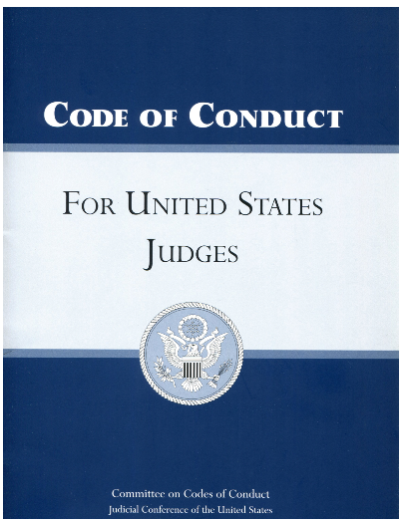
Codes of Conduct for U.S. Judges
Judges have an ethical obligation to:
Practice civility by being patient, dignified, respectful, and courteous to all persons with whom the judicial employee deals in an official capacity, including other employees and the general public.
Do not engage in sexual or ANY form of harassment of court employees or retaliate against those who report misconduct.
Harassment includes sexual/discriminatory harassment and other abusive, oppressive, or inappropriate conduct directed at judicial employees or others
Take appropriate action upon receipt of reliable evidence indicating a likelihood of conduct contravening the Codes of Conduct.

Slide 5
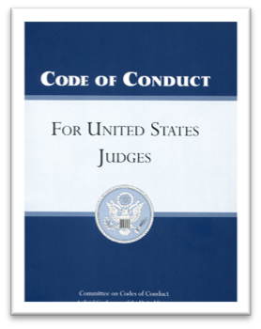
Code of Conduct for U.S. Judges
Canon 3(A):
(3) A judge should practice civility, by being patient, dignified, respectful, and courteous to litigants, jurors, witnesses, lawyers, and others with whom the judge deals in an official capacity.
(4) A judge should accord to every person who has a legal interest in a proceeding, and that person’s lawyer, the full right to be heard according to law.

Slide 6
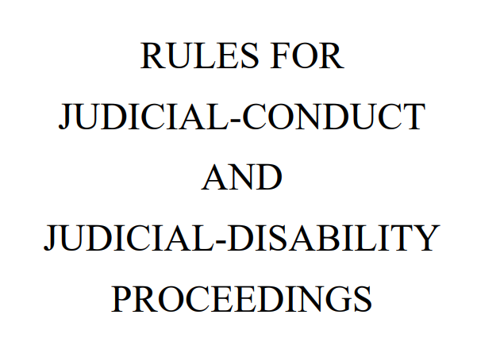
JC&D Rule 4(a)(2)
Cognizable misconduct includes:
(A) engaging in unwanted, offensive, or abusive sexual conduct, including sexual harassment or assault;
(B) treating litigants, attorneys, judicial employees, or others in a demonstrably egregious and hostile manner;

Slide 7
Assessing Abusive Conduct to Litigants as Misconduct: Key Factors
Was the judge’s conduct “prejudicial to the effective and expeditious administration of the business of the courts”? 28 U.S.C. § 351(a).
Case- and merits-comments are presumptively not misconduct because of the need to preserve the independence of judges.
JC&D Rule 4(b)(1): excludes from the definition of misconduct allegations “[d]irectly related to the merits of a decision or procedural ruling.” This exclusion preserves the independence of judges in the exercise of judicial authority by ensuring that the complaint procedure is not used to collaterally call into question the substance of a judge’s decision or procedural ruling.

Slide 8
Cognizable Misconduct Does NOT include:
An allegation that calls into question the correctness of a judge’s ruling, including a failure to recuse
UNLESS the decision or ruling is alleged to be the result of an improper motive, e.g., a bribe, ex parte contact, racial or ethnic bias, or improper conduct in rendering a decision or ruling, such as personally derogatory remarks irrelevant to the issues.
An allegation about delay in rendering a decision or ruling
UNLESS the allegation concerns an improper motive in delaying a particular decision or habitual delay in a significant number of unrelated cases.
JCD Rule 4 Cmt.: If the judge’s language was relevant to the case at hand — for example, a statement that a claim is legally or factually “frivolous” — then the judge’s choice of language is presumptively merits-related and excluded, absent evidence apart from the ruling itself suggesting an improper motive.

Slide 9
Examples – Misconduct Found
A Judge who, among other things, stated, “If you ask that question again, I might come over the bench and choke you,” was found to have engaged in misconduct
A Judge who, among other things, loudly pounded fist on bench and threated and yelled at attorney in angry voice during sidebar (jury could have heard) was found to have engaged in misconduct.
A judge who frequently made cavalier, flippant and derogatory comments demonstrated a pattern of disrespect for litigants, counsel and judiciary, and was found to have engaged in misconduct.
Judge agreed to a six-month suspension and counseling as a result of complaints of lengthy harangues of lawyers and once grabbing an attorney by the coat lapels.

Slide 10
Examples – Misconduct Found Re: the Litigant
Judge told teenage defendant that her life was a “garbage pit;” called her stupid and dishonest; and mocked her for taking public assistance.
Judge forced defendants, accused of alcohol-related offenses, to admit in court that they were alcoholics.
Judge refused during trial to return the walking cane of a defendant who had been accused of using the cane to damage a vehicle. The defendant had to ask for help to leave the witness box.

Slide 11
Examples – Not Misconduct
A judge's remarks during a trial “that are critical or disapproving of, or even hostile to, counsel, the parties, or their cases, ordinarily do not support a bias or partiality challenge.” A judge's ordinary efforts at courtroom administration—even a stern and short-tempered judge's ordinary efforts at courtroom administration—remain immune. The district judge’s comments are not the sort of “deep-seated and unequivocal antagonism” that may constitute misconduct. Liteky v. US, 510 U.S. 540, 556 (1994).
A judge who warned a party that their abusive and offensive motions served no purpose and would not be tolerated, found not to be misconduct.
A judge indicating that a defendant who provided substantial assistance could be seen as a “snitch” in prison, was found not to be misconduct.
“The judge did not use demeaning language or heap abuse on anybody. His statements were blunt but measured expressions of frustration with having his orders disregarded.” In re Complaint of Judicial Misconduct, 761 F.3d 1097, 1099 (9th Cir. Jud. Council 2014).

Slide 12
Improper Motive or Bias
Judge made disparaging remarks about a female attorney:
“It was a lot simpler when you guys wore dark suits, white shirts and navy ties. We didn’t let girls do it in the old days.” Federal District Judge Lunn Hughes.
The Fifth Circuit stated that “such comments were demeaning, inappropriate, and beneath the dignity of a federal judge.” United States v. Swenson, 894 F.3d 677, 681 n.3 (2018)
A complaint against a judge alleging he used the word “squaw” in reference to Native Americans was dismissed for corrective action after the Judge admitted that he did not know the term was offensive, acknowledged that now that he is aware, his conduct was inappropriate, and pledged not to use the word again.

Slide 13
USCourts.gov: Judicial Misconduct Resources and Information

Slide 14
The Judicial Conduct and Disability Complaint Process
INFORMAL– JC&D Rule 5.
If information reaches the Chief Circuit Judge, s/he can initiate a complaint if s/he has information constituting reasonable grounds for inquiry into whether the Judge has engaged in misconduct or has a disability.
OR
FORMAL COMPLAINT: JC&D Rule 6.
A complaint can be brought by any person against a federal judge; need not be the aggrieved victim or subject of the misconduct
Complaint Must be filed with the Subject Judge’s Circuit: The Circuit Executive in the Tenth Circuit

Slide 15
Informal: Chief Circuit Judge Initial Review
When a Chief Circuit Judge has information constituting reasonable grounds for inquiry as to whether a judge engaged in misconduct or has a disability, the Chief Circuit Judge may conduct an inquiry even if no formal complaint has been filed.
Purpose of the “limited inquiry” is to determine what action to take:
Communicating with complainant, Subject Judge, or witnesses;
Obtaining and reviewing transcripts and other documents.
Chief Judge may not make factual findings, determine an issue reasonably in dispute, or make a finding of judicial misconduct. A Special Committee must be appointed to make that determination.

Slide 16
Informal: Chief Circuit Judge Actions
Informal Resolution
Identify a complaint
If probable cause is found to believe misconduct occurred or that a disability exists, the Chief Circuit Judge may seek an informal resolution.
If no informal resolution achieved or is feasible, the chief judge may identify a misconduct complaint.
The Chief Circuit Judge must identify a complaint if the evidence of misconduct is clear and convincing, and no informal resolution is achieved or feasible.
* Only the Circuit Judge has power to identify a misconduct complaint

Slide 17
Formal Judicial Conduct and Disability Complaint
JC&D Rule 6: Formal Complaint: A complaint can be brought by any person against a federal judge; need not be the aggrieved victim or subject of the misconduct
Complaint Must be filed with the Subject Judge’s Circuit: Circuit Executive in the Tenth Circuit
Who Files Complaint
Complainant, or
CCJ Identifies Complaint
Chief Circuit Judge Actions
Limited Inquiry, and
Dismiss, or
Special Committee Actions
Investigate, and
Conclude, or
Refer to Special Committee
Send Report to Judicial Council with findings & Recommended Action

Slide 18
Formal Complaint: Chief Circuit Judge Actions
May Dismiss Complaint if:
not prejudicial to the effective and expeditious administration of the business of the courts;
is directly related to the merits of a decision;
is frivolous;
lacks sufficient evidence to raise an inference of misconduct;
allegations are incapable of being established through investigation
May Conclude a Complaint if:
the Subject Judge has taken voluntary corrective action;
For example: Acknowledgement and redress the harm (apology)
if intervening events render the allegations moot.
May Refer Complaint to Special Committee
Complainant may appeal dismissal or conclusion to Circuit Judicial Council

Slide 19
Special Committee Actions
If there is a question of fact or misconduct issue reasonably in dispute, a Special Committee must be appointed.
Special Committee investigates the complaint
Investigation may include use of experts and professionals.
Complainant may submit written evidence or argument to the Special Committee.
Subject Judge has right to respond to allegations.
Special Committee has subpoena power
Special Committee cannot take any action; it provides the Judicial Council with a report of its findings and a recommendation of what action to take.

Slide 20
Circuit Judicial Council Actions (After Appointment of Special Committee)
After Special Committee Recommendation, the Circuit Judicial Council may:
Dismiss the complaint
Conclude the proceedings
Take remedial action, including:
Private Censure
Public Reprimand
Initiate removal of Bankruptcy or Magistrate Judge
Request Retirement
Refer the matter to Judicial Conference of U.S. Courts if it finds the Subject Judge engaged in conduct constituting grounds for impeachment
Complainant can appeal a Special Committee dismissal or conclusion to the national judge Committee on Judicial Conduct & Disability

Slide 21
Public Decision
confidentiality
Public Availability
Generally, the consideration of a complaint is confidential.
If a Subject Judge and a Chief Judge consent in writing, the materials may be disclosed.
All orders entered by the Chief Judge and Judicial Council must be made public, without identifying the Subject Judge or complainant, when final action has been taken on a complaint. Some exceptions apply.

Slide 22
Colorado Standards of Conduct
Professional Conduct Rules for Colorado State Judges

Slide 23
Colorado Code of Judicial Conduct
Canon 1 - A Judge Shall Uphold and Promote the Independence, Integrity, and Impartiality of the Judiciary, and Shall Avoid Impropriety and the Appearance of Impropriety
Rule 1.2: A judge shall act at all times in a manner that promotes public confidence in the independence, integrity, and impartiality of the judiciary, and shall avoid impropriety and the appearance of impropriety.
Comment 1: Public confidence in the judiciary is eroded by improper conduct and conduct that creates the appearance of impropriety. This principle . . . includes harassment and other inappropriate workplace behavior.
Comment 3: Conduct that compromises or appears to compromise the independence, integrity, and impartiality of a judge undermines public confidence in the judiciary. . . .
Comment 5: Impropriety occurs when the conduct compromises the ability of the judge to carry out judicial responsibilities with integrity, impartiality and competence. Actual improprieties include violations of law, court rules or provisions of this Code. The test for appearance of impropriety is whether the conduct would create in reasonable minds a perception that the judge violated this Code or engaged in other conduct that reflects adversely on the judge's honesty, impartiality, temperament, or fitness to serve as a judge.

Slide 24
Colorado Code of Judicial Conduct
Canon 2 – A Judge shall perform the duties of judicial office impartially, competently, and diligently.
Rule 2.3(B): A judge shall not, in the performance of judicial duties, by words or conduct manifest bias or prejudice, or engage in harassment, including but not limited to bias, prejudice or harassment based on race, sex, gender, religion, national origin, ethnicity, disability, age, sexual orientation, marital status, socioeconomic status, or political affiliation. . . .
Rule 2.8(B): A judge shall be patient, dignified, and courteous to litigants, jurors, witnesses, lawyers, court staff, court officials, and others with whom the judge deals with in an official capacity. . . .
Comment: The duty to hear all proceedings with patience and courtesy is not inconsistent with the duty . . . to dispose promptly of the business of the court. Judges can be efficient and businesslike while being patient and deliberate.

Slide 25
Colorado Rules of Professional Conduct
Rule 8.3(b): A lawyer who knows that a judge has committed a violation of applicable rules of judicial conduct that raises a substantial question as to the judge's fitness for office shall inform the appropriate authority.
Rule 8.4: It is professional misconduct for a lawyer to, among other things, engage in conduct prejudicial to the administration of justice or to knowingly assist a judge or judicia officer in conduct that is a violation of applicable rules of judicial conduct

Slide 26
Colorado Rules of Professional Conduct
Rule 3.5: Impartiality and Decorum of the Tribunal
A lawyer shall not:
(a) seek to influence a judge, juror, prospective juror or other official by means prohibited by law;
(b) communicate ex parte with such a person during the proceeding unless authorized to do so by law or court order, or unless a judge initiates such a communication and the lawyer reasonably believes that the subject matter of the communication is within the scope of the judge's authority under a rule of judicial conduct;
. . . .
(d) engage in conduct intended to disrupt a tribunal.

