Slide 1
Who’s Behind the Curtain?
Insights from the Clerks Who Keep the District Court Running
Presented by supervisors of the District Court Clerk’s Office
Wednesday, April 19, 2023

Slide 2
Operational Divisions Attorney Services Case Administration Court Operations Jury Services

Slide 3
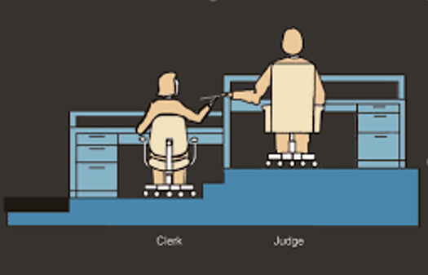
CASE ADMINISTRATION

Slide 4
Andrea García Gallegos, Case Administration Supervisor
CASE ADMINISTRATION
Began with court in 1998: Civil division generalist,
Pro Se Writ clerk, Lead Operations Support clerk
Manage Case Administration Specialists (CAS) &
Operations Support Clerks (OSC) in Intake Dept.
Initial case opening & processing, pro se assistance, docketing assistance

Slide 5
Common Misconceptions in Case Admin
CASE ADMINISTRATION
Rules & policies regarding restricted events
Deletion of errant filings from docket
Asking the Clerk’s Office for the judge’s ruling on a motion
Asking the Clerk’s Office for legal advice
Waiting until the last minute to file

Slide 6
Common Misconceptions in Intake
CASE ADMINISTRATION
Deletion/correction/replacement of errant initial filings
Text-Only entry vs. Docket entry w/.pdf attachment
Asking Clerk’s Office for legal advice
Administrative notices
Providing services of your office staff

Slide 7
Tips for Success
CASE ADMINISTRATION
Learn how to personally file in CM/ECF.
Use “Search” option available in CM/ECF.
Mistakes happen. Call Clerk’s Office for guidance before attempting to correct.
Visit “Electronic Filing” section on court’s website.
Policies and practice standards
Training material
Have patience with the court’s staff.

Slide 8
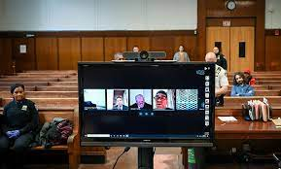
COURT OPERATIONS

Slide 9
Nick Richards, Court Operations Supervisor
COURT OPERATIONS
Began with court in 2010 as Courtroom Deputy
Manage Courtroom Deputies (CRDs), Court Reporters, Interpreter Administrator
CRDs: staff hearings, produce minutes, handle exhibits, run courtroom technology
Reporters: maintain record for Article III judges and occasionally MJ matters
Interpreters: assist parties who require interpretation

Slide 10
Common Misconceptions in Court Operations
COURT OPERATIONS
“I WANT THE TRUTH BEST PRACTICES!”
- Tom Cruise, A Few Good Men

Slide 11
Common Misconceptions in Court Ops
COURT OPERATIONS
“Can’t court staff cover some of my paralegal’s duties while in court?”
“It’s OK to arrive for a hearing 2 minutes before the start time.”
This is especially problematic for criminal cases. You will need time to discuss the case with your client!
If you cannot avoid being late, inform chambers and be sure to apologize once court is in session.
“Can’t I sit when addressing the Court or making an objection?”
“It’s OK for me to interrupt opposing counsel or bypass the Court to address opposing counsel directly.”
Court reporters and interpreters cannot follow!
Doing so makes for a potentially messy record.
“Well, if I can do it in state court, can’t I do it here?”

Slide 12
Suggestions for Success in the Courtroom
COURT OPERATIONS
Read pertinent orders issued on your case.
Know local & federal rules.
Read judge’s practice standards.
File a motion if you wish to appear remotely.
Book a tech training in advance with CRD.
Present professionally before the Court, even if a remote hearing.

Slide 13
Suggestions for Success in the Courtroom (cont’d)
COURT OPERATIONS
Court is not required to provide interpreters for civil matters
EXCEPTION #1: cases instituted by the government
EXCEPTION #2: cases involving hearing-impaired parties
Slow down and speak clearly for court reporters and interpreters.
Upon appeal, transcript requests should be immediately filed in both district and circuit (appellate) court.
Complete Transcript Order Form (TOF) accurately.
CJA Panel attorneys should file TOF and eVoucher documentation.
Be kind to court staff!

Slide 14
ATTORNEY SERVICES

Slide 15
Edward P. Butler, Legal Officer
ATTORNEY SERVICES
Mark Fredrickson, Legal Specialist - 2006
Attorney (inactive), former law clerk in TX federal court
Attorney Admissions & Discipline guru
Ashley Sheehan, Paralegal - 2021
Paralegal at insurance defense law firm
Pro Bono Panel & PACER Exemptions
High profile functionalities
New Bar admissions or reinstatement from admin removal
CM/ECF troubleshooting
Inability to access docketing events
Bill of Costs hearings

Slide 16
ATTORNEY SERVICES
Duties Supporting Court Operations Include:
- Attorney Admissions | - Attorney Discipline
- Certificates of Good Standing / Letters of Disciplinary History | - Biennial / Renewal Fee process
- CM/ECF problem solving | - Pro Se E-filing registration
- Civil Pro Bono Panel program | - Bills of Costs hearings
- General attorney troubleshooting | - Naturalization ceremonies

Slide 17
Common Misconceptions
ATTORNEY SERVICES
My ECF problem is easily solved by calling the Clerk’s Office.
NO. PACER is now the Overlord – call the “Mother Ship” first.
CM/ECF is now a part of PACER (“NextGen”). If you have a CM/ECF problem, call (800) 676-6856.
- Forgotten Username/Password
- Account Management & Billing
- Record viewing is not the same as E-Filing
I paid the Biennial Fee in 2020. I’m still good, right?
Wrong. You must pay the Biennial Renewal Fee every two years, in the Fall. The next Renewal Fee will be collected
in the fall of 2024.
Related myth: I was admitted in September of 2022. I’m too new to have to pay the Renewal Fee.
Wrong. Anyone admitted prior to Oct. 1 of the Biennial Renewal Fee year must pay the fee starting Oct. 1.
A Bill of Costs is just a formality. I won my case, so I’ll file a Motion for Costs.
Wrong. See the USDC website page “Bills of Costs - Guide and FAQs” (under Court Operations  Rules & Procedures)
The Court’s website only has court announcements and other things that don’t affect me.
Wrong. Use the website’s top menu bar for info. on numerous categories, including Information for Attorneys. Also use the “Search” tool in the upper right corner. The court’s website has EVERYTHING and is current.

Slide 18
Common Misconceptions
ATTORNEY SERVICES
The Colorado Supreme Court imposed discipline against me. Since they sent a notice to all courts, I don’t have to do anything else, correct?
Wrong. You must self-report to this court, under local rule LAttyR 4, when you have been suspended or disbarred
for any reason.
I only practice in bankruptcy court, so I am not subject to biennial fees or other local district court rules?
Wrong. You must comply with all District Court local rules, including paying biennial fees and remaining active in at least
one jurisdiction to practice in bankruptcy court (an inactive attorney caught practicing in the bankruptcy court was ordered
to return over $20,000 in fees).
The Colorado Supreme Court reinstated me, so can I now immediately practice in the district or bankruptcy court?
Wrong. You must seek reinstatement with the district court under LAttyR 11 or you are practicing law without a license.
If I am disciplined by the U.S. District Court, it will be confidential and no one will ever know about it, correct?
Wrong. Per local rule LAttyR 12(b) - Public Matters, orders entered by the court’s Disciplinary Panel concerning attorney
admission, reinstatement, readmission, relief from the rule of good standing, disability inactive status, censure, suspension, disbarment, and dismissal after a response has been filed by the respondent shall be accessible to the public and, accordingly, are published on the court’s website on the Attorney Discipline page here:
http://www.cod.uscourts.gov/AttorneyInformation/AttorneyDiscipline.aspx.

Slide 19
ATTORNEY SERVICES
Do’s
Visit the Attorney Information tab on the U.S. District Court website for all Attorney topics: http://www.cod.uscourts.gov/AttorneyInformation.aspx
Most services are routed to the PACER system, so go there FIRST for maintenance of your account.
Go to the District of Colorado’s CM/ECF e-filing system to do such things as ordering certificates of good standing, making the biennial $50 fee payments, etc.
Certificates of Good Standing: Submit your online request through your NextGen CM/ECF PACER account.
Change of Contact Requests: Submit these to PACER, not the U.S. District Court, but do file a Notice in any existing open cases.
Read all the comprehensive instruction booklets of the Attorney Services Division on the various topics the Division handles (see Attorney Information tab on the U.S. District Court website referenced above).
Don’ts
Submit a Certificate of Good Standing request by e-mail, phone call, or in person.
Forget to pay the next Biennial Renewal Fee - The next payment period will be Oct. 1, 2024, and December 31, 2024.
Submit an “Application for Readmission or Reinstatement to the Bar of the Court Pursuant to D.C.COLO.LAttyR 11” for readmission after you have been Administratively Removed. The Readmission/Reinstatement Application is for Not in Good Standing/Suspended/Disbarred attorneys.
Call or write the Clerk’s Office when you need to update your contact info.
Call or write the Attorney Services Division before reading the instruction booklet available online. There are no short-cuts!

Slide 20
Practice Reminders
ATTORNEY SERVICES
Bar Admission procedures are now processed through PACER Central Sign-On (NextGen) – no more Attorney Services Portal.
New method to order Certificates of Good Standing – through CM/ECF
New procedures for the Biennial Fee Collection and Administrative Removal processes
New method to submit your change of contact requests to PACER, not the U.S. District Court (but do file a notice in any existing open cases)
Attorney Services/Admissions
(303) 335-2466
COD_attorneyservices@cod.uscourts.gov
PACER Service Center
for questions about your NextGen CM/ECF Login & Password
(800) 676-6856
pacer@psc.uscourts.gov
Case Administrative Specialists
for expertise on docketing and filings
District judges (303) 335-2026
Magistrate judges (303) 335- 2390

Slide 21
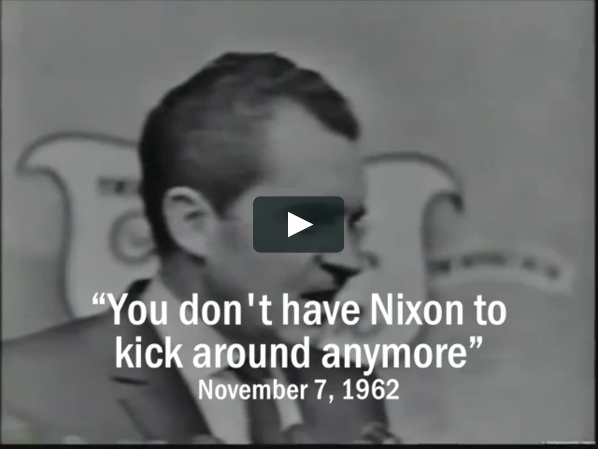
ATTORNEY SERVICES
Butler

Slide 22
JURY SERVICES
Notes:
Most immediately think of all the reasons why they cannot or do not want to do it.

Slide 23
Shelley L. Moore, Jury Administrator
JURY SERVICES
Graduate of Missouri State University
Legislative, campaign, and intellectual property work
Began with court in 1998: USPO, Courtroom Deputy, Operations Analyst, Jury Administrator
Provide petit (trial) and grand jurors for the district
Notes:
Intro, then…
What comes to mind when you hear “jury duty?”

Slide 24
What We Do
JURY SERVICES
Team of 3: Two Jury Assistants + Jury Administrator
Build master jury wheel every two years
Each county’s number of registered voters is proportionally represented in the jury wheel.
Create petit and grand jury pools, determine eligibility
Summon, explain process, pay juror fees/expenses, handle juror requests, employment issues
Travel to Durango, Grand Junction, and Colorado Springs
Facilitate statistical reporting to AO
Notes:
All jury needs are processed through the Denver office. The three of us take care of all federal jurors within the District (Colorado).
Master Jury Wheel: Sec. of State voter registration list, DMV driver’s licenses and adult ID’s.
Eligibility: US citizen, 18+ years old, read/write/understand English, not in an exempted profession, if a felon rights must be restored
The summoning/qualification process takes about 6 weeks.
Statistics are two-fold: account for every person inconvenienced/paid, demographics of the master jury wheel are reflective of the community

Slide 25
Common Misconceptions
JURY SERVICES
We are disgruntled, apathetic government workers doing the bare minimum.
“Why hasn’t anyone responded to my email sent at 1AM on the weekend?!” [Monday @ 8:00 am]
USDC only summons from a single county.
We have access to all other courts’ records, including criminal history.
Juries are routinely sequestered overnight for the length of the trial.
Notes:
We often hear potential jurors’ surprise that we are nice, or that they’ve reached an actual person.
We summon from the whole state. The state is divided into quadrants. The court location to which you are summoned depends upon the county where you reside.
Other courts’ records: we don’t know who/when other courts may have summoned you. We do not have credentials to access NCIC/CCIC, Scotland Yard or MI6.
Can you transfer me to Denver County? Do you have the number to my local jury office?

Slide 26
JURY SERVICES
Did You Know?
Unlike state law, there is not a federal statute that requires employers to pay a given number of days’ wages while an employee is on jury duty.
Most petit jurors are on-call for a one month term, calling each Friday.
Most trials are about five days long.
Grand jury panels: Denver (2), Durango (1), Grand Junction (1)
Denver panels meet 1-3 days per month for one year.
Durango & Grand Junction panels meet 1 day per month for one year.
Notes:
Many organizations follow the CRS and apply the same to federal jury duty.
Although on-call for a month, vast majority only report once and some not at all. We can work around some conflicts.

Slide 27
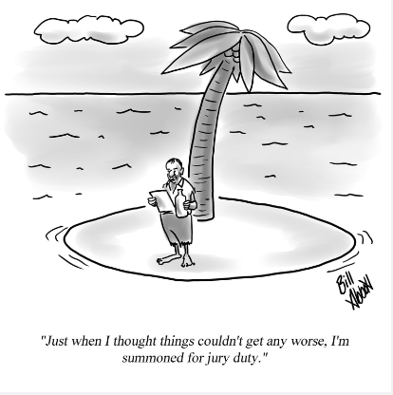
JURY SERVICES
Notes:
This leads us to Do’s and Don’ts….

Slide 28
JURY SERVICES
Do’s
Recognize we aren’t trying to ruin your life
Read the summons
Complete the questionnaire timely
Beware of scams
Do your part, it’s a privilege!
Don’ts
Research potential jurors
Try to communicate with jurors
If you’re a potential juror, do not research or post about the case
Provide excruciating details of health issues
Clam up before the judge
Notes:
DO:
You did not receive a summons because you’ve been targeted for misfortune!
The summons contains all the vital information.
Questionnaires are to be completed within 10 days of receipt.
Nationwide scammers call trying to convince you that you’ve missed jury duty and need to pay a fine over the phone or be arrested.
After serving most people appreciate the experience and learn a lot.
DON’T:
Researching jurors is not acceptable; it’s creepy.
Attorneys and public may not enter the JAR/attorney lounge when jurors are present.
Researching the case/target for grand jury or posting about jury duty = trouble.
Once picked as a juror, staff cannot get you off the hook.

Slide 29
JURY SERVICES
You Can’t Make This Stuff Up!
- actual excerpts from our peers -
“I need to be excused. I am caring for a six-week old... ”
The “six week old” was later discovered to be a puppy.
“I hate people.”
“I’m essential at my job and cannot miss work, and I have a two-week vacation during this time.”
“Why do I get summoned every two years? I moved out of Denver to prevent this type of thing.”
Occupation: Listen to my wife, steering wheel holder
“My name is… I cook on a wood stove I do not want to be bothered or disrupted and cutting up terrorists right now and I want to stop stop this silly thing…” [auto transcription]
“This was a wonderful experience and, much to my surprise, I am going to miss it.” – Former grand juror
Notes:
Upon follow up, the woman admitted the six-week old was NOT a human, but a puppy.
Some people are very surly and loaded for bear when they call. The other extreme is the 75 year old who lives in Sedgwick County (very NE corner), is barely mobile, but is willing to come if needed.
We have heard some extreme requests: how do I ensure I never get called again (die, change your citizenship, don’t drive or register to vote), how much is it to just pay the fine,
Occupation: Some have a sense of humor… marital status “single and ready to mingle”

Slide 30
Who’s Behind the Curtain?
Insights from the Clerks Who Keep the District Court Running
QUESTIONS?

